Slide 1
Exploring Virtualisation and Monitoring Opportunities in Networking
Elisantila Gaci, RASH
WiFiMon Service Manager
Workshop Yerevan, Armenia
5 October 2023
www.geant.org
Notes:
Hi Everyone, yeah I know I’m not anymore new on the stage ☺ I’m WiFiMon service manager

Slide 2


Notes:
Hi Everyone, yeah I know I’m not anymore new on the stage ☺ I’m WiFiMon service manager
I’m going to show you a service that will help to feel see and understand your wifi.

Slide 3
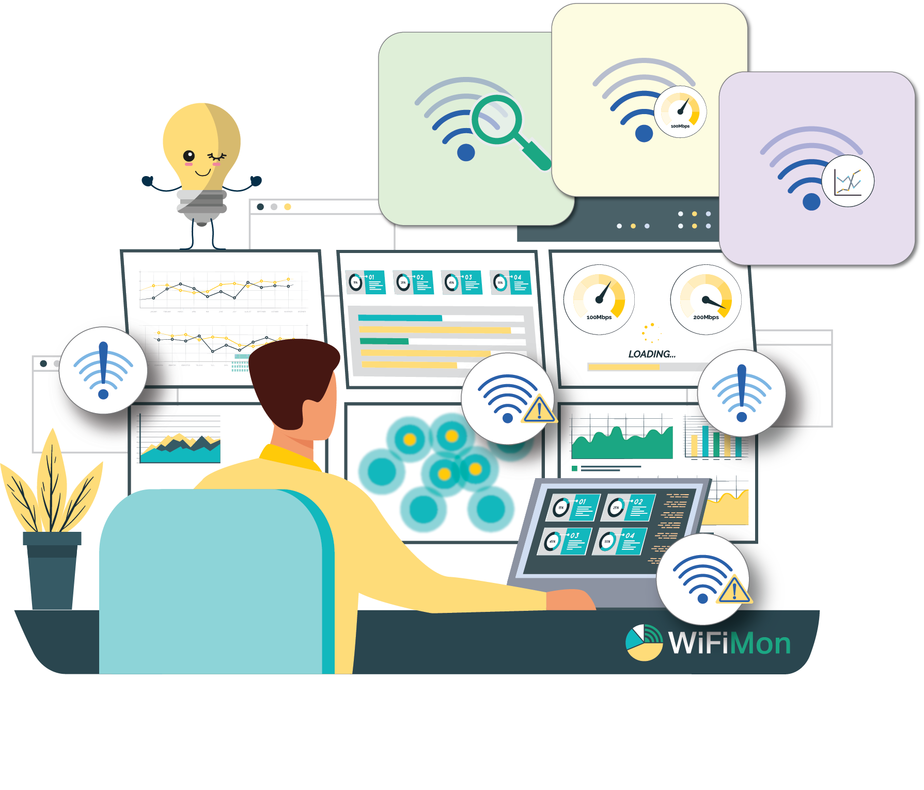
WiFiMon: Introduction
An open-source wifi network monitoring and performance verification system
Vendor - independent,
Transparent to the WiFi network users
Uses well-known open-source components
Independent of WiFi network technology
Captures user’s perception of the network quality
Notes:
WiFiMon is an open-source Wi-Fi network monitoring and performance verification system. Which is vendor-independent, transparent to the Wi-Fi network users which means that measurements are triggered automatically upon visiting a monitored website and there is no need for end users to install any application. It is independent of Wi-Fi network technology. Captures users experience of the network, quality and provides metrics like download/upload throughput , latency, signal strength, link quality.
But how WiFiMon really works?

Slide 4
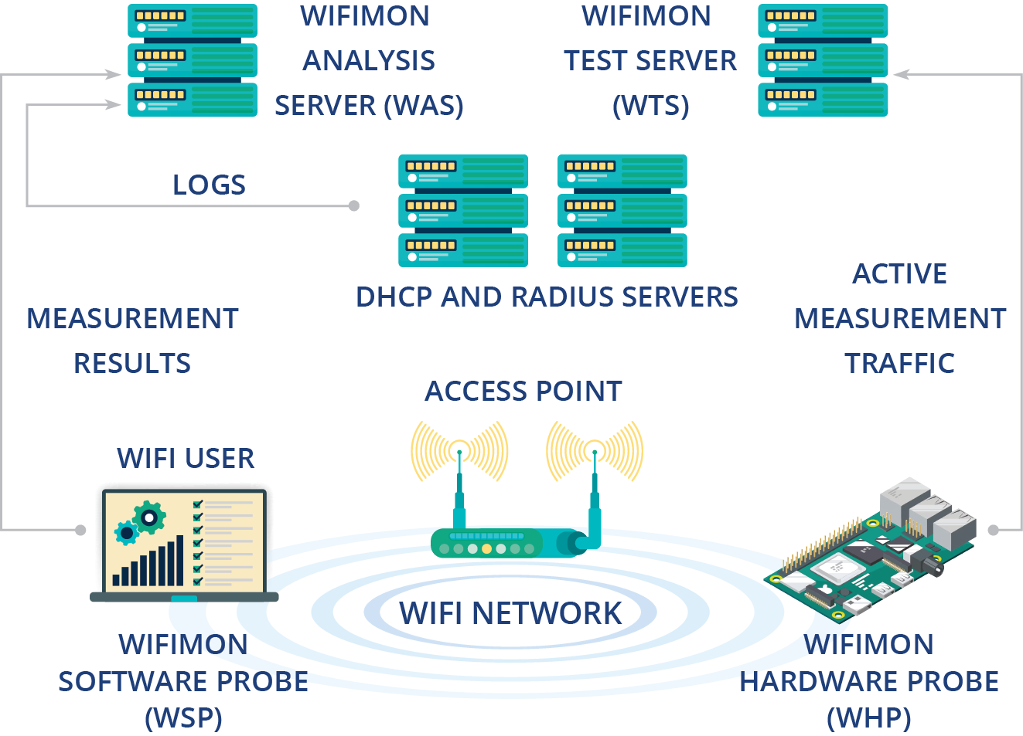
How it works
WiFiMon relies on two monitoring data sources:
Crowdsourced measurements
Hardware probe measurements
Performance data collected from active measurements:
Calculated by end-devices (WSP's and WHP's)
Streamed to the WAS
Optionally correlated with RADIUS/DHCP logs for richer analysis
Visualized through various dashboards of the WAS;
Notes:
Wifimon relies on two monitoring data sources: 1. crowdsources measurements from end users roaming the network and 2. hardware probe measurements from fixed network locations.
Performance data collected from active measurements:
Calculated by end-devices (WSP's and WHP's)
Streamed to the WAS
Optionally correlated with RADIUS/DHCP logs for richer analysis
Visualized through various dashboards of the WAS
Who is it for?

Slide 5










GÉANT Symposium 2020
Who is it for
NRENs
Campus Networks
Conference Venues
Notes:
Many NREN’s have shown interest on using this service and some of them are using like ASNET and RASH and others that have shown interest lately like CERN, etc.
WiFiMon can be used in network laboratories like NETMODE Laboratory at NTUA
And also, at conference venues like GÉANT Symposium 2020 and TNC19, that we had pilots there and they were considered successful

Slide 6
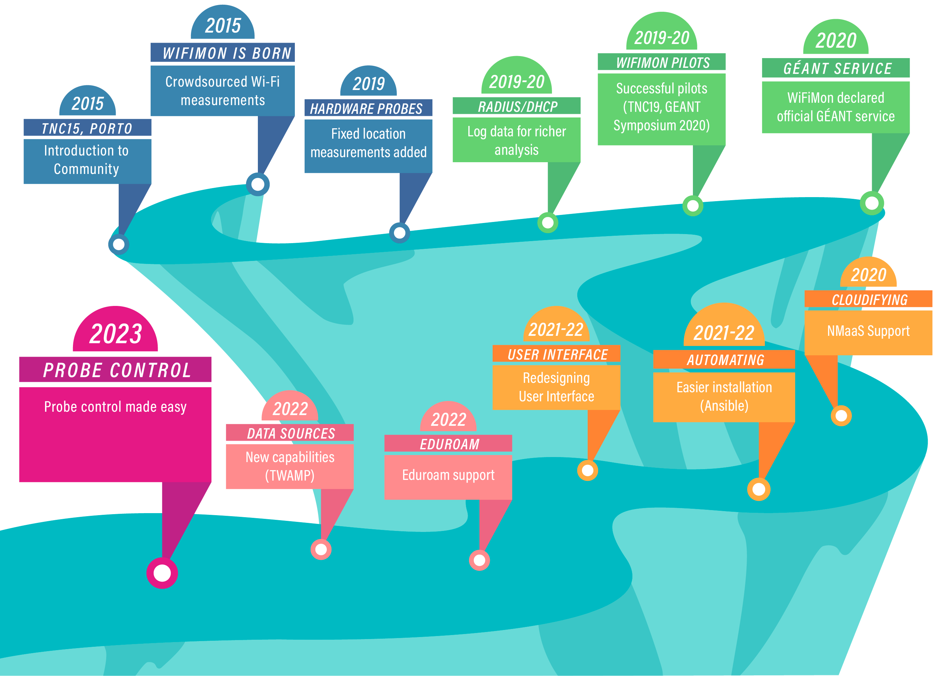
Notes:
2015 and the idea of WiFiMon was born: Monitoring the performance of Wi-Fi networks as experienced by their end users without requiring their intervention, presented
to the community at TNC15, Porto. End-user crowdsourced measurements are complemented by
hardware probes that monitor Wi-Fi performance from fixed network positions, whereas data from RADIUS and DHCP logs are used to report performance per network Access Point, thus enabling the detection of underperforming Wi-Fi segments. WiFiMon capabilities will be subsequently challenged by monitoring the conference venues of prominent GÉANT meetings. WiFiMon pilots in TNC19 and GÉANT Symposium 2020 delivered promising results and led to the declaration of WiFiMon as an official GÉANT service. To offer better services, WiFiMon is integrated with NMaaS to cloudify some of its components, automating wifimon installation. Additional steps are also followed: WiFiMon becomes more user friendly by redesigning its User Interface, support for eduroam monitoring is provided, whereas WiFiMon monitoring capabilities are
enriched by incorporating popular network monitoring solutions and standardized protocols, e.g., TWAMP. WiFiMon team is currently trying to simplify probe configuration and control; automation tools are employed to configure probes from a centralized location, while reducing administrator effort.

Slide 7
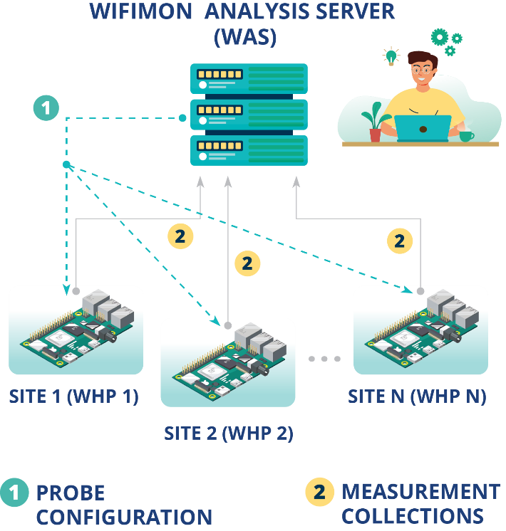
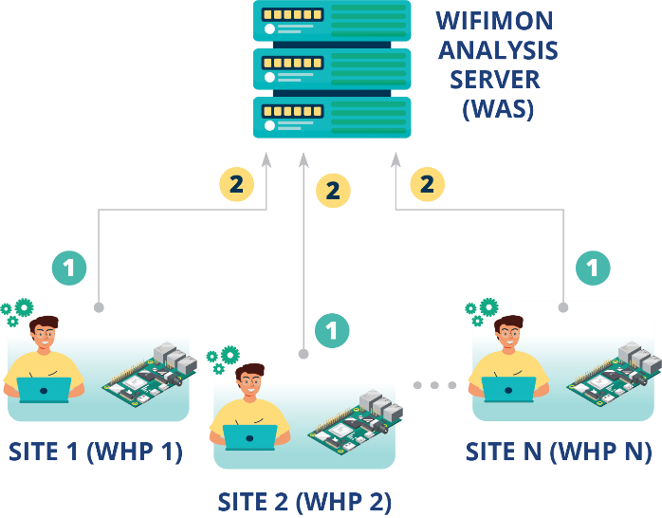
WHP Configuration & Control
Old approach
Administrator feedback demonstrated limitations:
In NAT networks
In public networks
Administrators edit config directly
Novel approach required!!!
Remote & user-friendly configuration of WHP’s from a central point (WAS)
Flexibility to control WHP’s behind NAT networks
Notes:
We see two pictures:
The picture on the left we can see multiple probes, we see that the administrator, the yellow one, should go to each of them, configure them, for example plug in and monitor, otherwise, hard network configurations would be required.
On the right one the administrator from the center of points connects to the probes and everything happens more flexible.

Slide 8
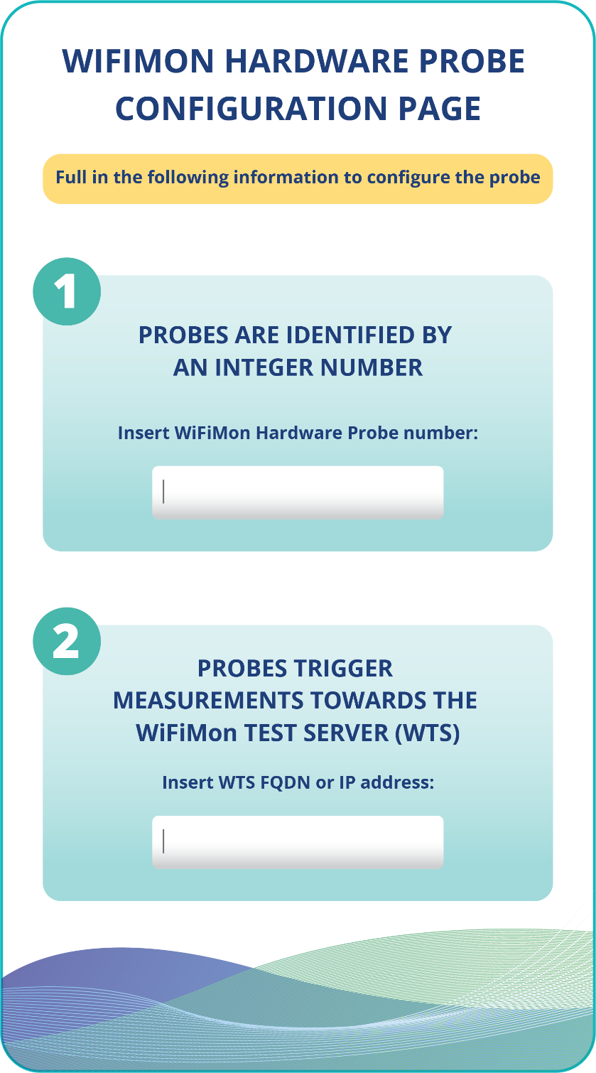
WHP Configuration Made easy
Administrators (re)configure WHP’s from the WiFiMon UI
Provided data:
Device ID
FQDN’s/IP addresses of WiFiMon components
Location information
Configuration files are generated based on Jinja2 templates
Notes:
Using Jinja2 templates network administrator go the new user interface receives input from the user, it controls where brackets are and substitute with values.

Slide 9
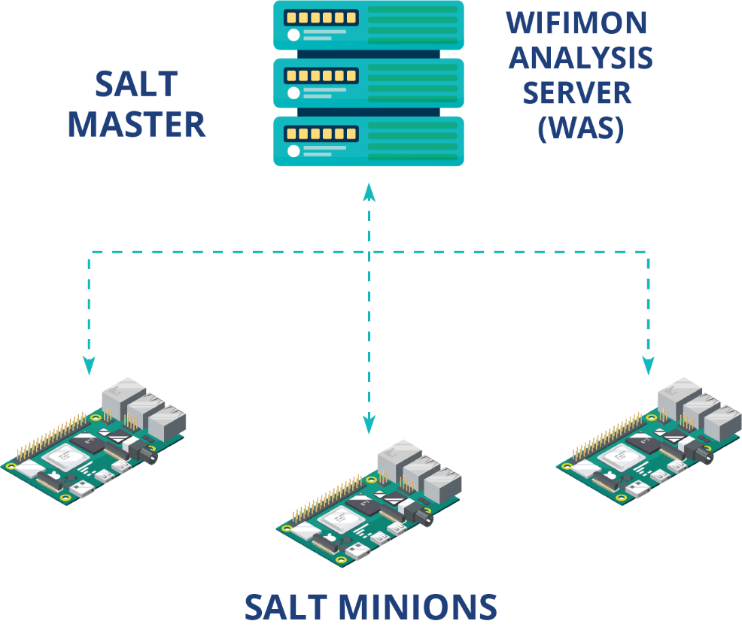
Remote WHP Configuration Made Possible
Solution based on the Salt infrastructure management tool
WiFiMon Analysis Server → Salt Master
WiFiMon Hardware Probes → Salt Minions
Notes:
Solution based on the Salt infrastructure management tool.
WiFiMon Analysis Server à Salt Master- the device that manages everything is called the master.
WiFiMon Hardware Probes à Salt Minions- the devices that are managed are called the minions.
Later
Server is the master, and the probes are the minions.
The idea here is that if we see the picture, we have 3 minions, if I enter a command for the 3 of minions, configuration will happen in parallel. What will ansible do,
ansible, will connect to the first one configures, then connect to the second one, configure etc for the 3 of them, we are having delays. Salt uses this message broker to
configure the probes in parallel. So, if you have 3 probes or thousands of probes, things will require the same time.

Slide 10
Remote WHP Configuration Made Possible
Salt establishes application layer communication: - WHP’s are remotely configured from the WAS
Remote reconfiguration possible even for WHP’s behind NAT
Public IP addresses are not required → IP space is not consumed
1
Salt includes a ZeroMQ message broker: Parallel configuration regardless of the WHP number
2
Configuration files generated from templates are transferred from the WAS to the respective probes
3
Notes:
Salt establishes application layer communication: - WHP’s are remotely configured from the WAS.
Remote reconfiguration possible even for WHP’s behind NAT
Public IP addresses are not required à IP space is not consumed.
Using Salt, you can find the probe behind NAT without knowing IP addresses, or using names, public IP addresses are not required. But of course, a IP address but not a public one.
Salt includes a ZeroMQ message broker: Parallel configuration regardless of the WHP number.
A queue that receives a lot of messages and distributes them to a lot of clients. The idea here is that if we see the figure, we have 3 minions, if I enter a command for the 3 of minions, configuration will happen in parallel. What will ansible do, ansible, will connect to the first one configures, then connect to the second one, configure etc for the 3 of them, we are having delays. Salt uses this message broker to configure the probes in parallel. So, if you have 3 probes or thousands of probes, things will require the same time.
Configuration files generated from templates are transferred from the WAS to the respective probes.
We are using these tools to copy files from the salt master to the salt minions.

Slide 11


Future work
Machine learning for performance prediction
More visualization options

Slide 12
Thank You
WiFiMon mailing list: wifimon-ops@lists.geant.org

